Slide 1
The future of C#
Ivan Towlson
GreenButton
developer.greenbutton.com

Slide 2
What just happened?

Slide 3
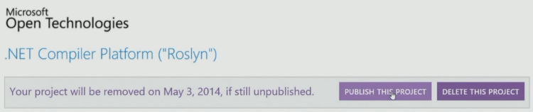

Slide 4
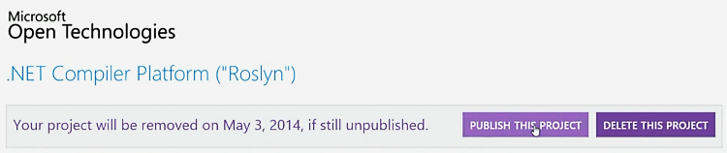

Slide 5
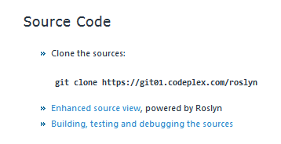

Slide 6
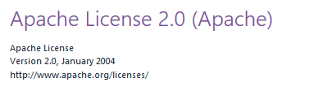

Slide 7


Slide 9
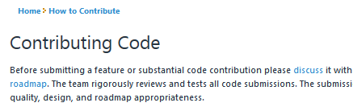

Slide 10
What just happened?

Slide 11
What’s coming in C# 6?
http://roslyn.codeplex.com/wikipage?title=Language%20Feature%20Status

Slide 12
Simplified class implementation
http://roslyn.codeplex.com/wikipage?title=Language%20Feature%20Status

Slide 13
Convenience features
http://roslyn.codeplex.com/wikipage?title=Language%20Feature%20Status

Slide 14
Pseudo-dynamic style
http://roslyn.codeplex.com/wikipage?title=Language%20Feature%20Status

Slide 15
Tidying and fixes
http://roslyn.codeplex.com/wikipage?title=Language%20Feature%20Status

Slide 16
Are you going to mention VB?
http://roslyn.codeplex.com/wikipage?title=Language%20Feature%20Status

Slide 17
Roslyn
also known as the .NET Compiler Platform

Slide 18
…is open
also known as
“Why I didn’t call this talk ‘What’s new in C# 6’”

Slide 19
Thanks!
Ivan Towlson
GreenButton
https://github.com/itowlson/future-of-csharp/
http://developer.greenbutton.com
http://hestia.typepad.com/flatlander
ivan@greenbutton.com
ivan@hestia.cc

